Slide 1

2023-2024
COACH MEETING

Slide 2

Club Mission: Houston Stellar strives to provide a premium experience for all players and families, while competing to be a top-notch club in the state and nation!
Idea behind the club: To provide a positive experience for young female athletes through the sport of volleyball.

Slide 3
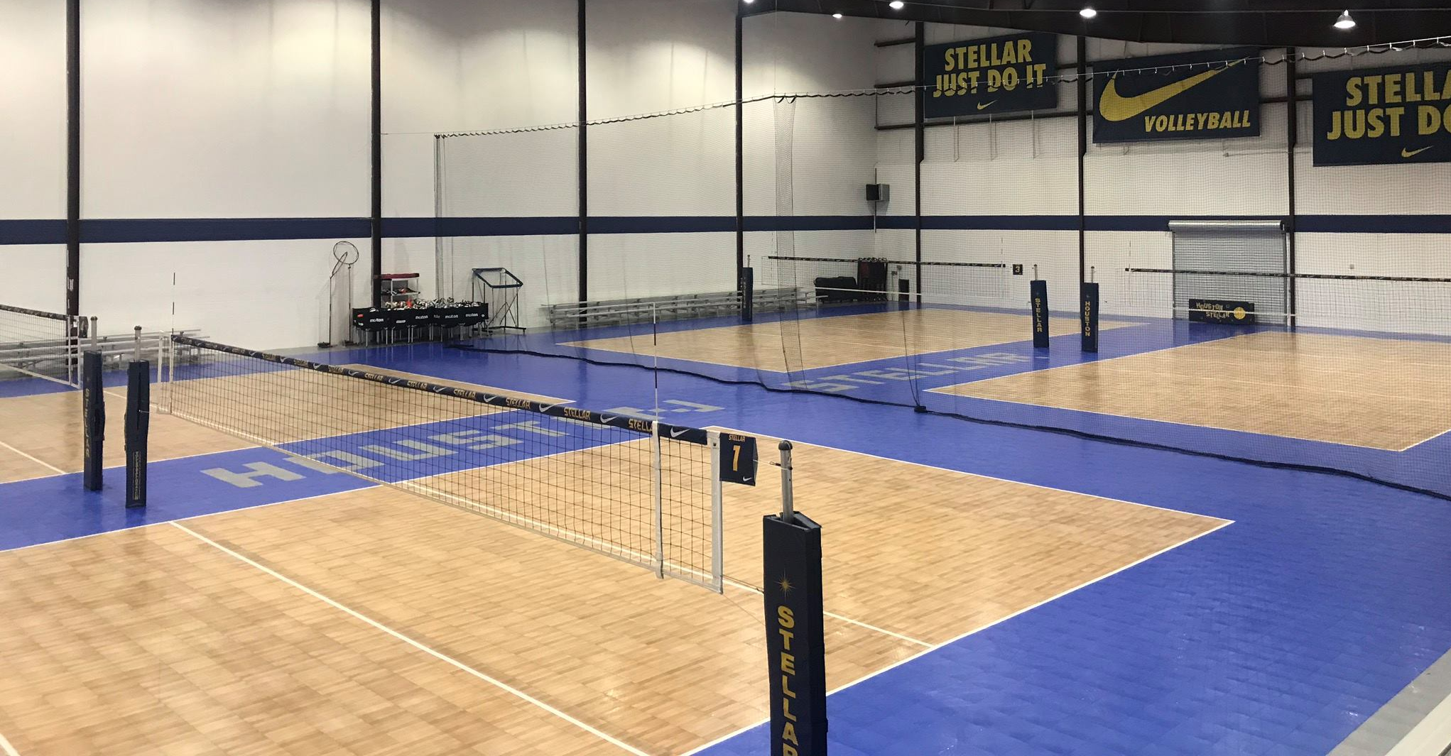
DEFINING ROLES

Slide 4
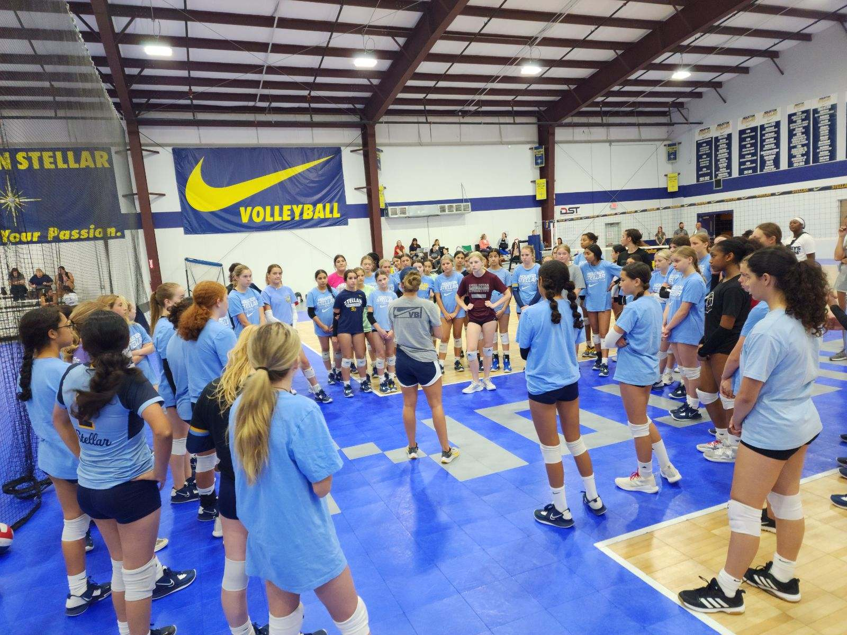
ROLE OF THE CLUB
PROVIDE TRAINING, TOP LEVEL COACHING, FACILITY, & EQUIPMENT
RECRUITMENT OPPORTUNITES
OPEN LINE OF COMMUNICATION
INFORMATIVE WEBSITE
COMPETITIVE SCHEDULES
HONEST & CONSISTENT
ENVIRONMENT

Slide 5
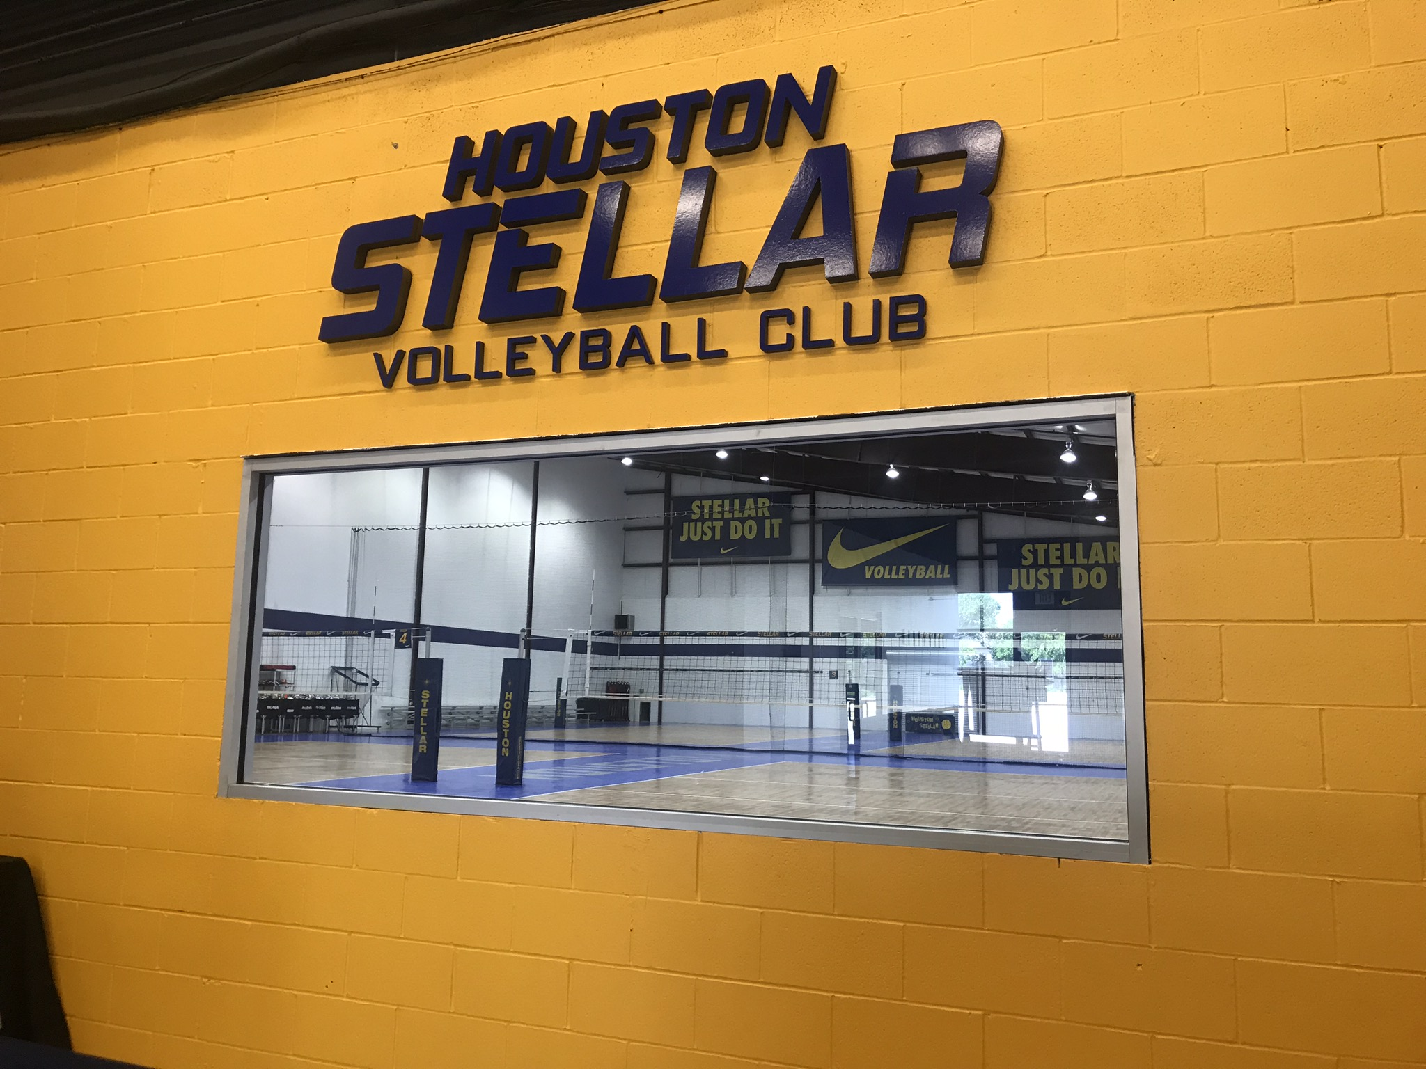
CLUB POLICIES, PROCESSES, & PROCEDURES
We are a business that provides a service
Nike Sponsorship: Coaches and Players honor this.
No outside food or drink
Concessions – On Your Honor
Retail – Flash Store
Court Clean Up
In Season Lessons
Issuing Ball Bags

Slide 6
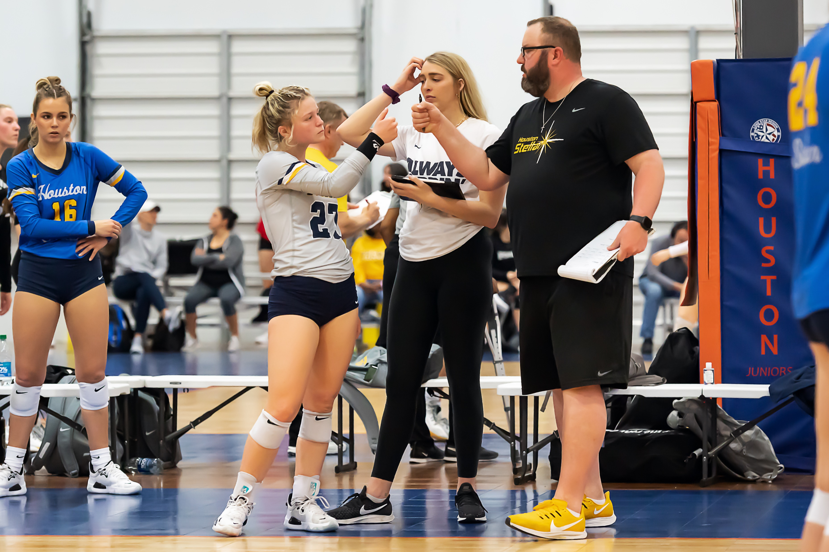
COACH POLICIES PROCEDURES
INDEPENDENT CONTRACTORS vs EMPLOYEES
  PAID FOR SERVICE TO COACH
  1099 AT END OF YEAR VS W2
  RESPONSIBLE FOR YOUR OWN TAXES
  AUTO, FOOD, TRAVEL DEDUCTIONS – RESEARCH REQUIREMENTS ETC.
COMPENSATION
  MONTHLY PAYMENTS LAST DAY OF MONTH – AUTO DEPOSIT
  ABSENSES: $60/$40 PRACTICE, $150/$100 TOURNEYS/DAY
  ALL ABSENSES MUST BE REPORTED TO SCOTT
  ASST. COACHES PAID FOR TAKING PRACTICE $20, TOURENY $50
  TRAVEL PER DIEM – $100-175 / TOURNEY. ADDED TO MONTH PAY
  REIMBURSE FOR AIRPORT PARKING AND OR UBER. RECEIPTS NEEDED.

Slide 7
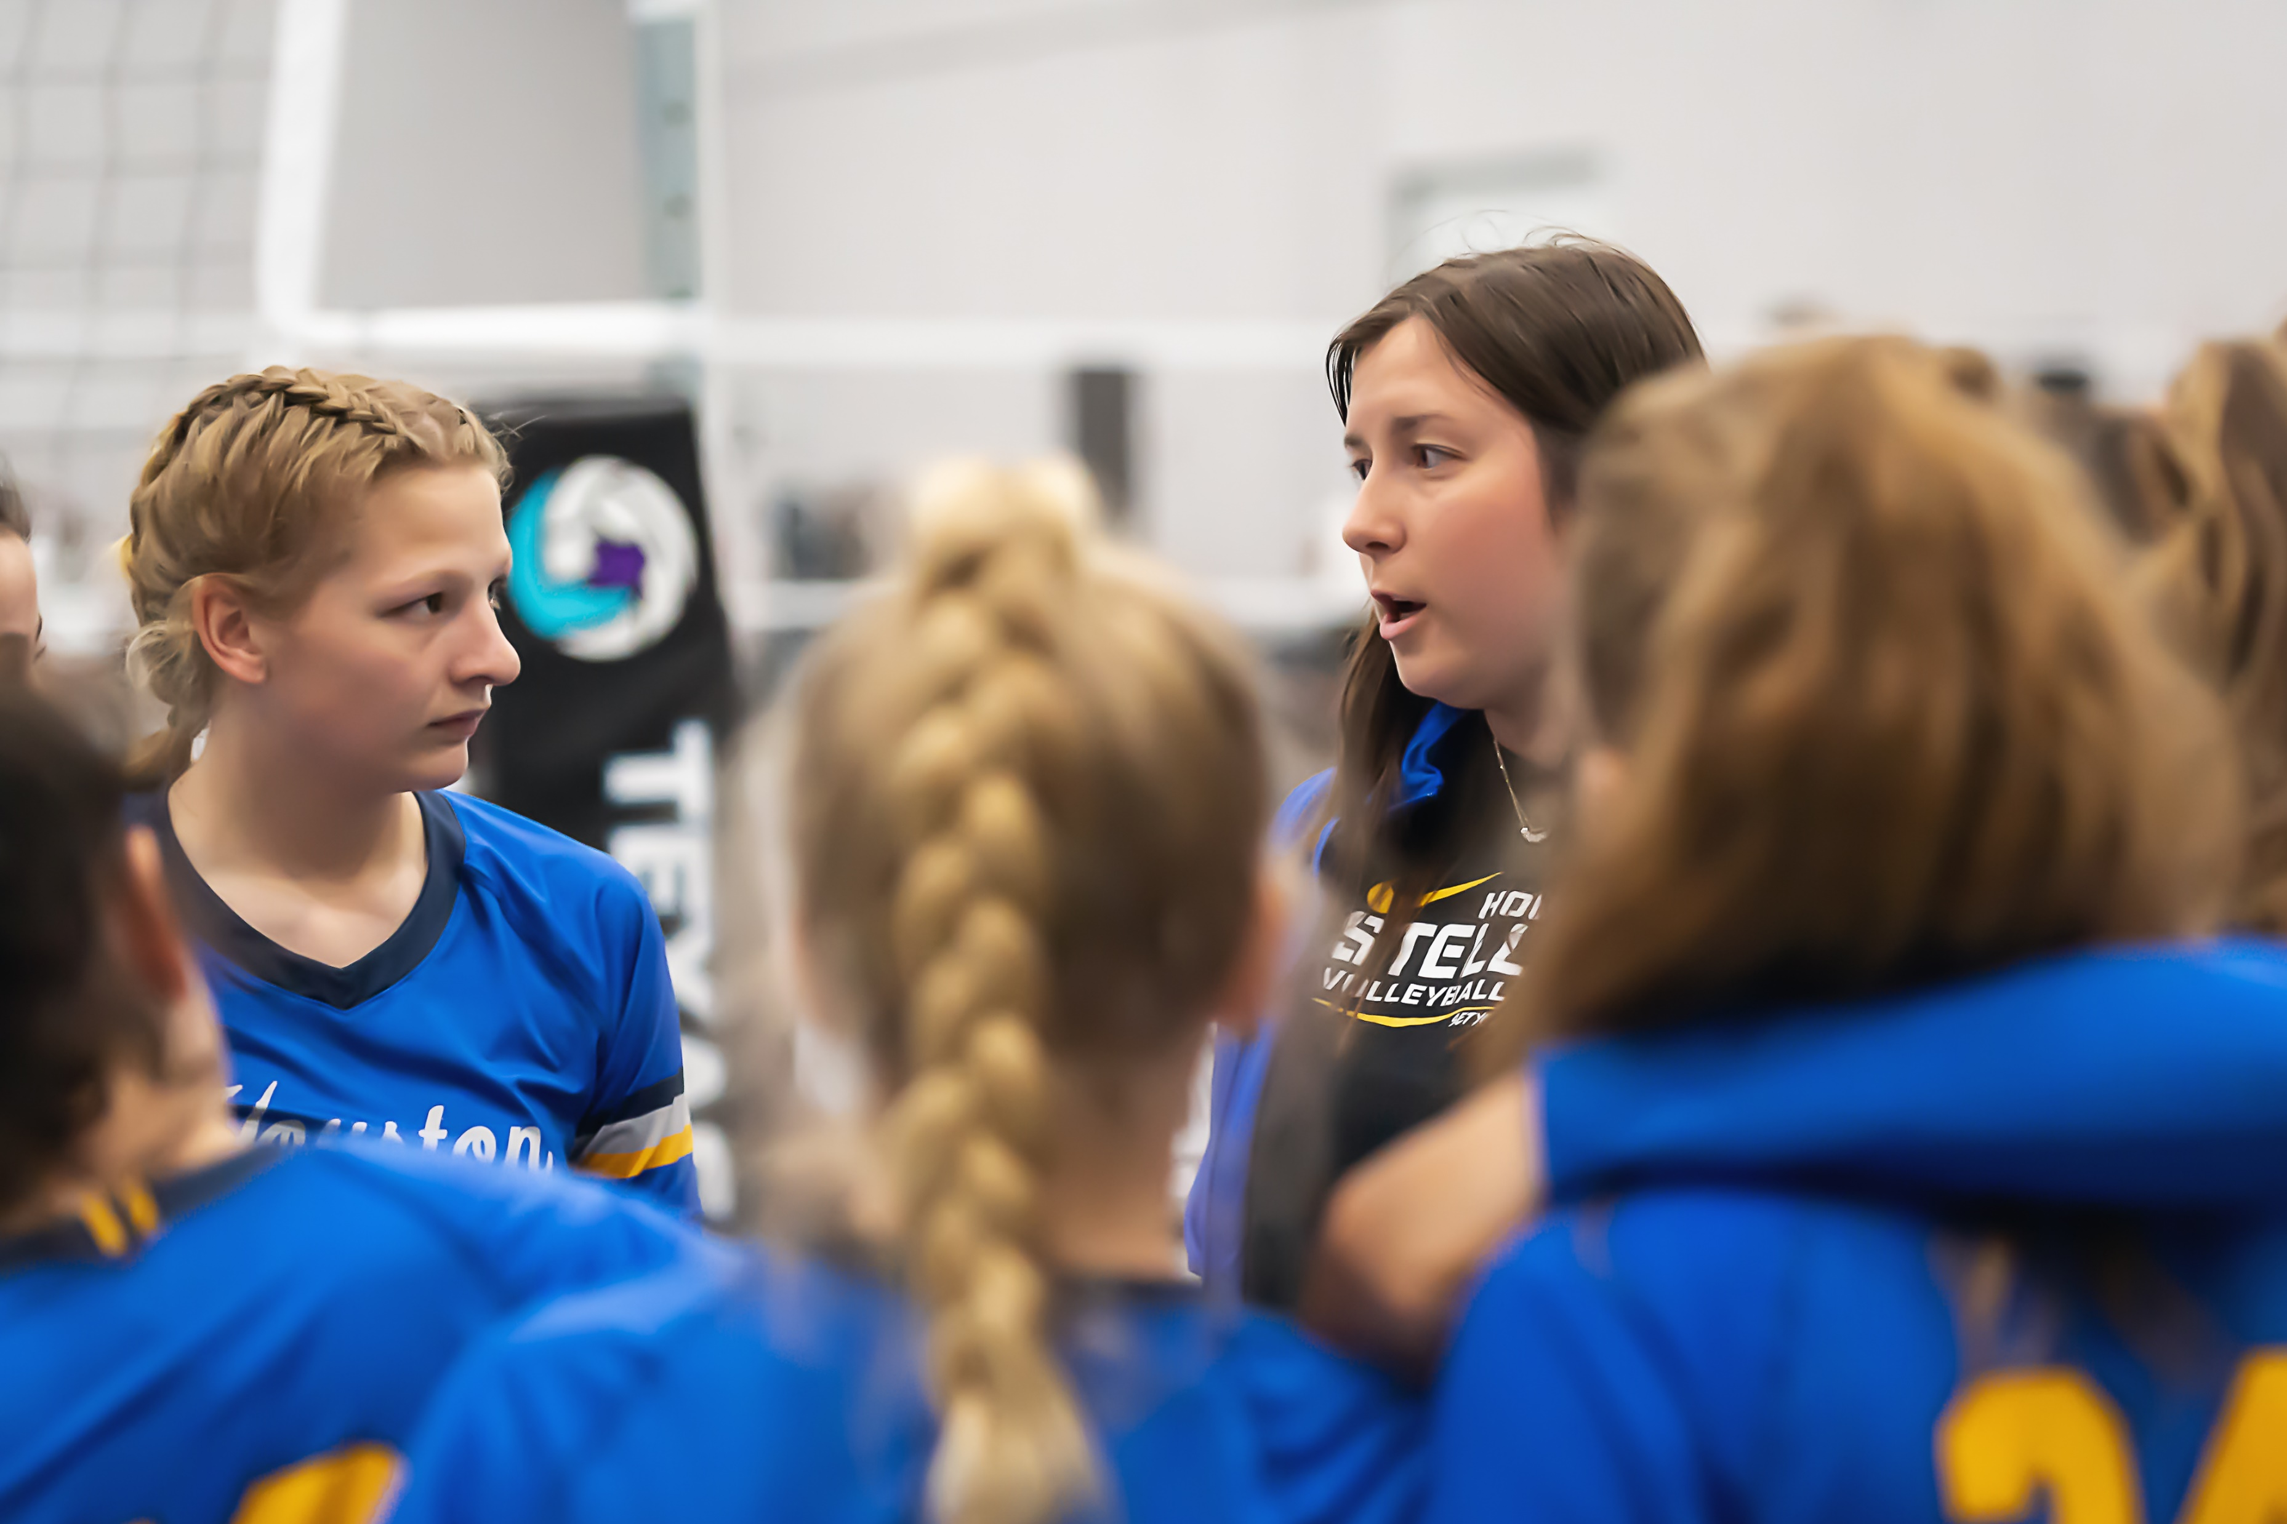
ROLES OF OUR COACHES
REPRESENT THE CLUB & YOURSELF
  COMPETITIVE ADVANTAGE FOR STELLAR
  BE PRESENT, BE ON TIME, AND BE AN EXAMPLE
  BE INVESTED IN THE PROCESS
  HOLD PLAYERS TO A HIGH STANDARD
  ENFORCE CLUB POLICIES
  PRACTICE WITH PURPOSE & FOR GROWTH
PAY ATTENTION TO YOUR SCHEDULES & COMMUNICATION
  KNOW WHERE, WHEN, AND WHO YOU PLAY OR REF
  COMMUNICATE TO THE PARENTS ON THE TEAM 1ST
  READ & RESPOND TO GROUP ME & EMAILS
  ALL PLAYERS SHOULD WANT TO COME BACK TO STELLAR NEXT YEAR

Slide 8
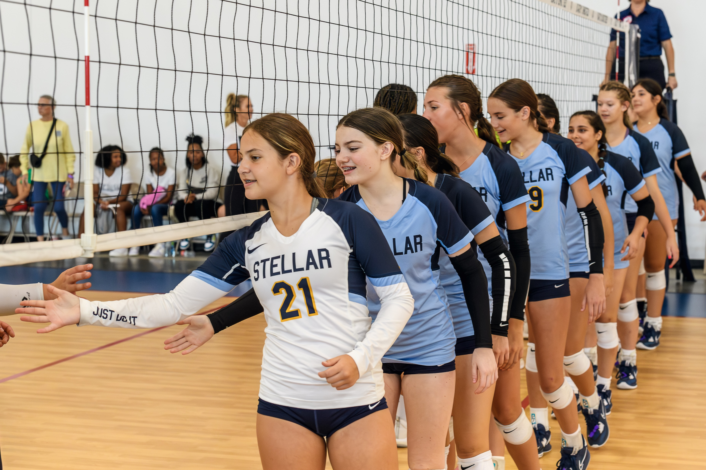
TRAINING TO BE CURRENT, HIGH LEVEL, & SET OUR ATHLETES APART.
AREAS OF FOCUS
PRACTICES/TRAINING
  POSITIONAL TRAINING & TEAM TRAINING
TOURNAMENTS/MATCH PLAY
  KNOW YOUR LINE UPS, SUBSTITUTIONS, LIBERO, & RULES!
TEAM MANAGEMENT
  COMMUNICATE PROPERLY, GIVE OPPORTUNITIES, PLAYER MEETINGS,
  PLAY TO WIN BUT ALSO ALLOW FOR OTHERS TO CONTRIBUTE
  BE STRONG & CONSISTENT, BUT MAKE IT FUN (FIND BALANCE)
  DON’T ALLOW PARENTS TO BULLY YOU OR OVERSTEP.
WHAT STELLAR STANDS FOR

Slide 9
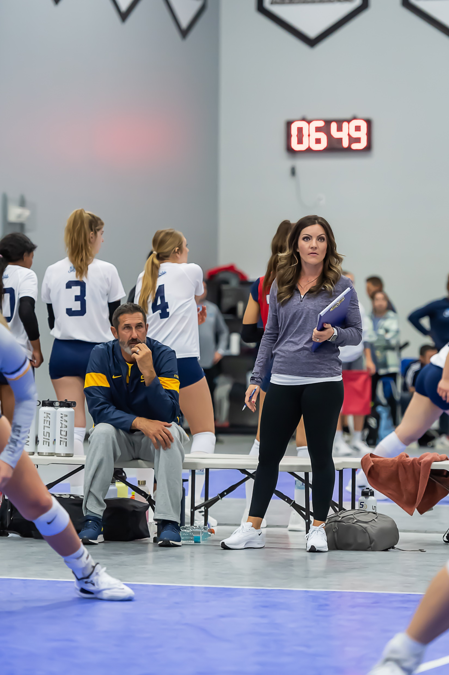
TOURNAMENTS
MOST TO ALL TOURNAMENT INFORMATION IS ON AES.
SCHEDULES ARE USUALLY RELEASED THE WEDNESDAY BEFORE THE TOURNAMENTS.
EMAIL OUT TO THE PARENTS ON YOUR TEAM WELL BEFORE THE WEEKEND. PROVIDE LOCATION, TIME, TEAM REMINDERS, ETC…
MAKE SURE YOU REMIND YOUR PLAYERS TO BRING ALL JERSEYS, SPANDEX, & WHATEVER ISSUED GEAR THAT MAKES SENSE.
HAVE A ROTATION PLAN FOR REF DUTIES. THIS HAS TO BE CLEARLY COMMUNICATED AT THE BEGINNING OF THE SEASON. WE NEED TO BE TOP NOTCH WHILE REFFING.
24 HOUR POLICY ON MEETING WITH PLAYERS & PARENTS ABOUT PLAYING TIME… DO NOT ENGAGE AT A TOURNAMENT!

Slide 10
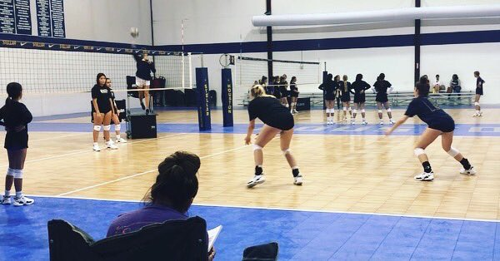
PRACTICES
BEHIND PAYMENT PLAYERS ARE NOT ALLOWED TO PARTICIPATE.
CANCELING PRACTICES – THIS IS A RARE OCCURANCE & NOT ENCOURAGED.
CHECK ALL PLAYERS TO MAKE SURE THEY ARE WEARING APPROPRIATE ATTIRE.
CLUB WIDE WARM UP / LEADING INTO BALL HANDLING.
EQUIPMENT – PLEASE TAKE CARE OF WHAT WE HAVE!
  BALL CARTS : NO TRASH, NO CONES/SCOREBOARDS, NO ADDED BODY WEIGHT
  PICKING UP PROPERLY AFTER EACH PRACTICE SESSION IS OVER.
  DON’T PUSH BOXES ALONG THE GROUND. MUST BE TURNED ON WHEELS TO MOVE
START & END ON TIME FOR ALL PRACTICES.
POLICIES ON PLAYERS THAT ARE LATE, ABSENT, ETC… (PARENT WEBSITE)
PARENT SITE (PASSWORD: onamission24 )
BE ORGANIZED, BE PREPARED, & HAVE A PLAN WITH FOCUS.

Slide 11
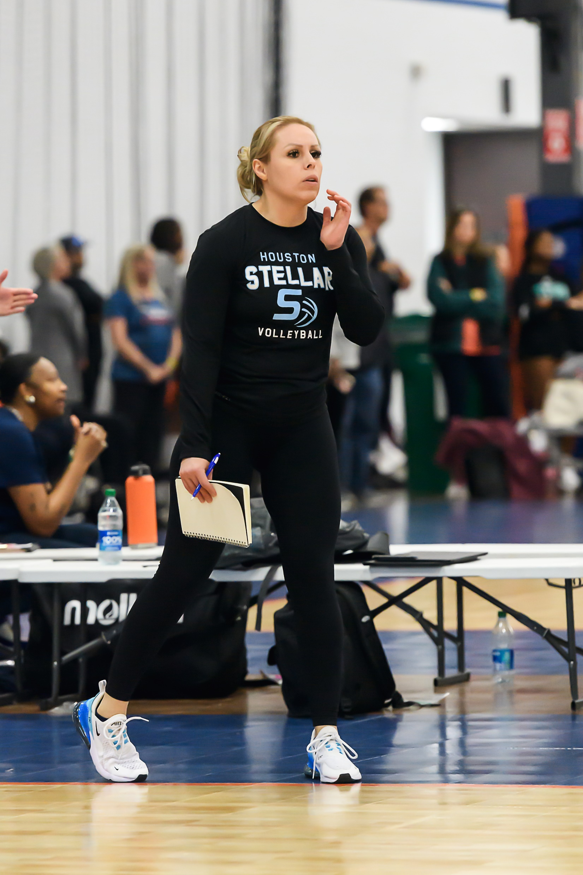
EXPECATIONS OF OUR COACHES
KNOW TODAY’S GAME
    KNOW HOW TO TRAIN ALL SKILLS
    WE CROSS TRAIN OUR PLAYERS.
    GIVE ALL PLAYERS OPPORTUNITIES IN
    SERVE RECEIVE AND DEFENSE!
  KNOW HOW TO MANAGE GAME SITUATIONS
    MANAGING SUBS
    ROTATIONS / LINE UPS
    MAKE SMART DECISIONS
    PLAY TO WIN AND KNOW HOW TO MANAGE YOUR ROSTER TO GIVE OPPORTUNITIES!!!!
  KNOW WHO TO ASK FOR HELP!
    DIRECTORS or VETERAN COACHES
    COME WATCH DIFFERENT PRACTICES.

Slide 12
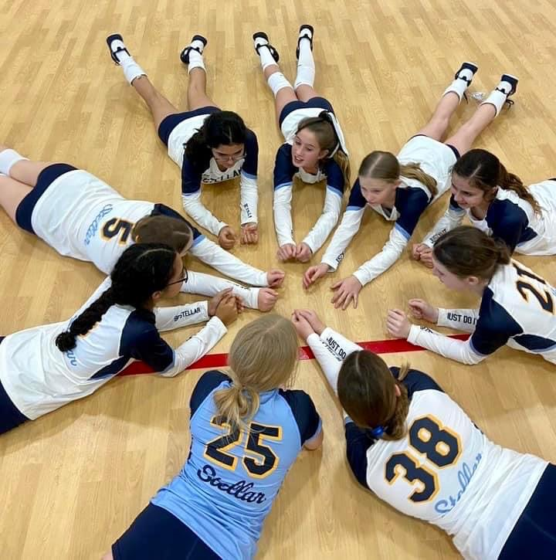
COACHING WEBSITE & RESOURCES
GOOD RESOURCES FOR SEASON INFORMATION
Coach Site (password: 2024coaches)
  COACH CONTACTS
  SEASON POLICIES
  *TRAVEL COACHES: HOTELS & FLIGHTS
  CLUB PRACTICE SCHEDULE
  COACH IMPACT, SAFE SPORT, USAV MEMB.
  REF CERTIFIED = CLINIC & RATING & EMAIL
Region Website (some information)
AES for tournament information or other tourney sites
(usually updated the Wednesday before play)
PLEASE BE RESOURCEFUL

Slide 13
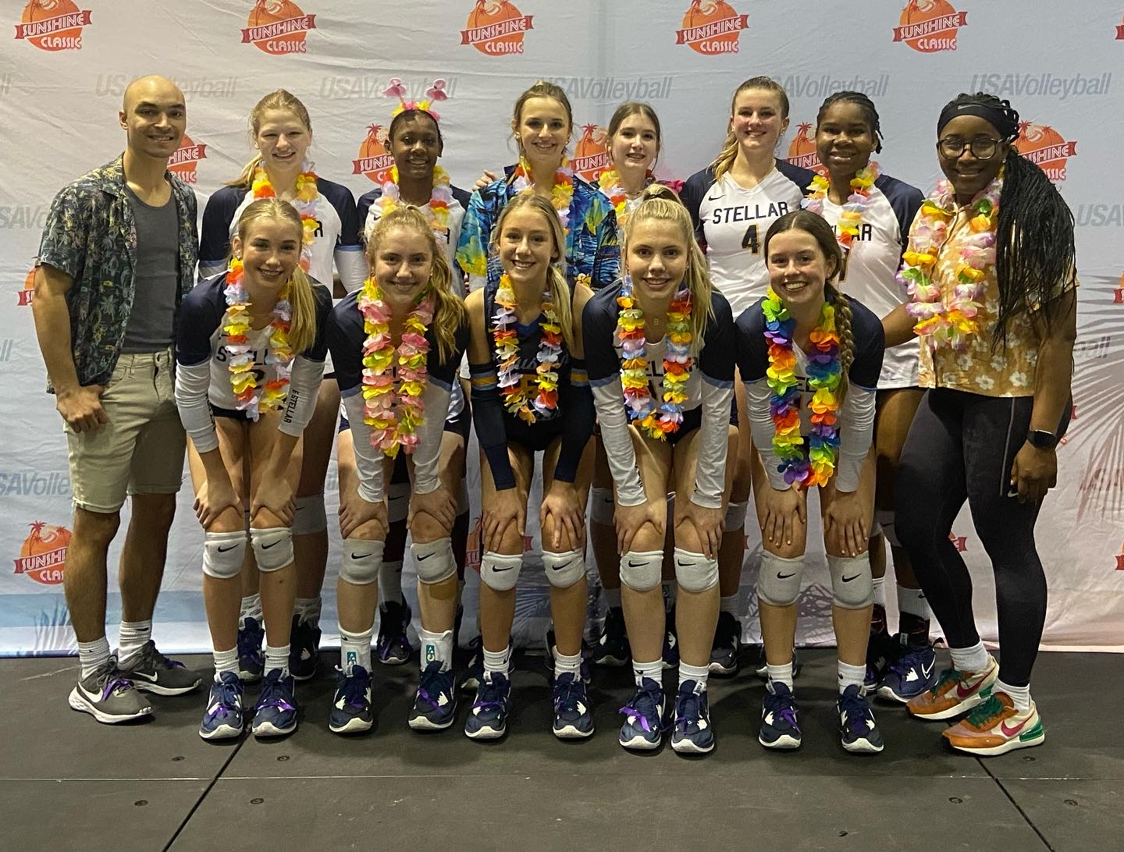
Travel Team Policies /Expenses
  Hotel Room, Tax, and parking will be credit card authorization.
  Hotel and Volleyball Venue Parking reimbursed with receipts.
  Uber, Lyft, Taxi reimbursed with receipts.
  Airport Parking $10/day reimbursed with receipts
Coaches are asked to share rides while driving to out of town tournaments
Traveling – Stellar Gear
All Uber, Lyft, Taxi - share rides with other coaches
Changing Flights

Slide 14
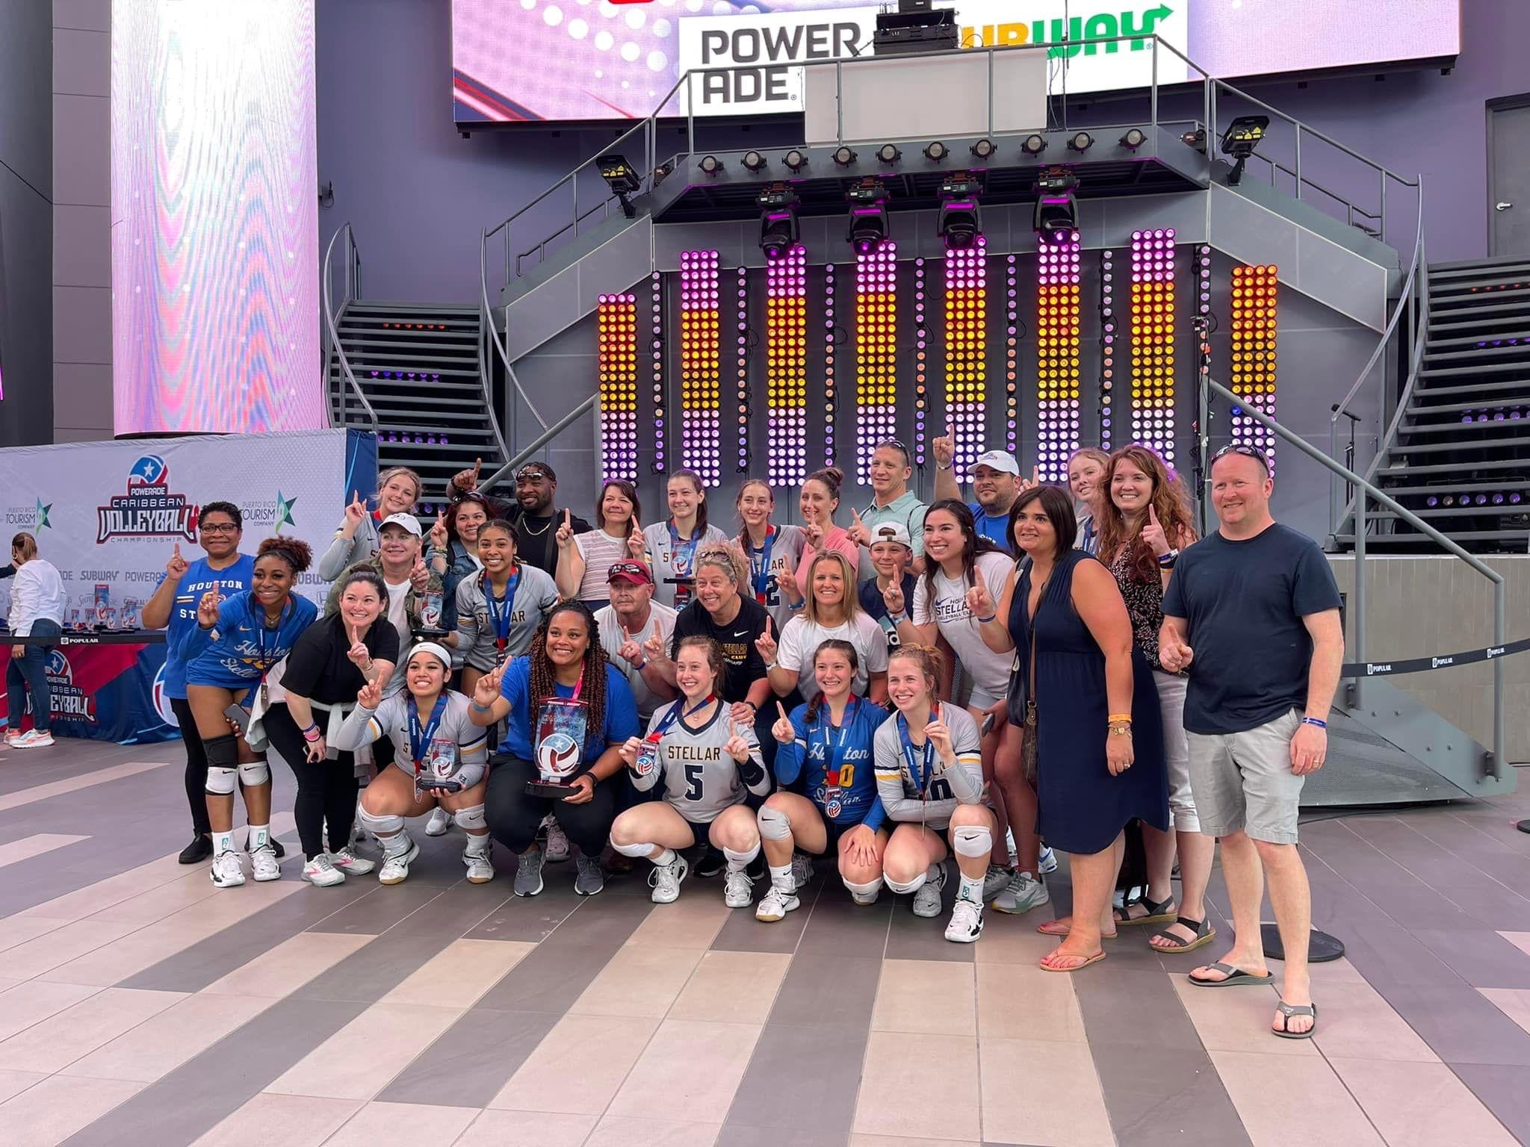
ROLE OF THE PARENTS
SUPPORT THE TEAM, COACH, & CLUB
UNDERSTAND THE COMMITMENT INVOLVED BY HELPING
ATHLETES ARRIVE ON TIME AND ATTEND ALL TEAM EVENTS
BE A FAN ( NOT A COACH OR REF )
HELP COORDINATE TEAM EVENTS
BE POSITIVE TOWARDS THEIR
PLAYER AND TEAM
HUDL

Slide 15
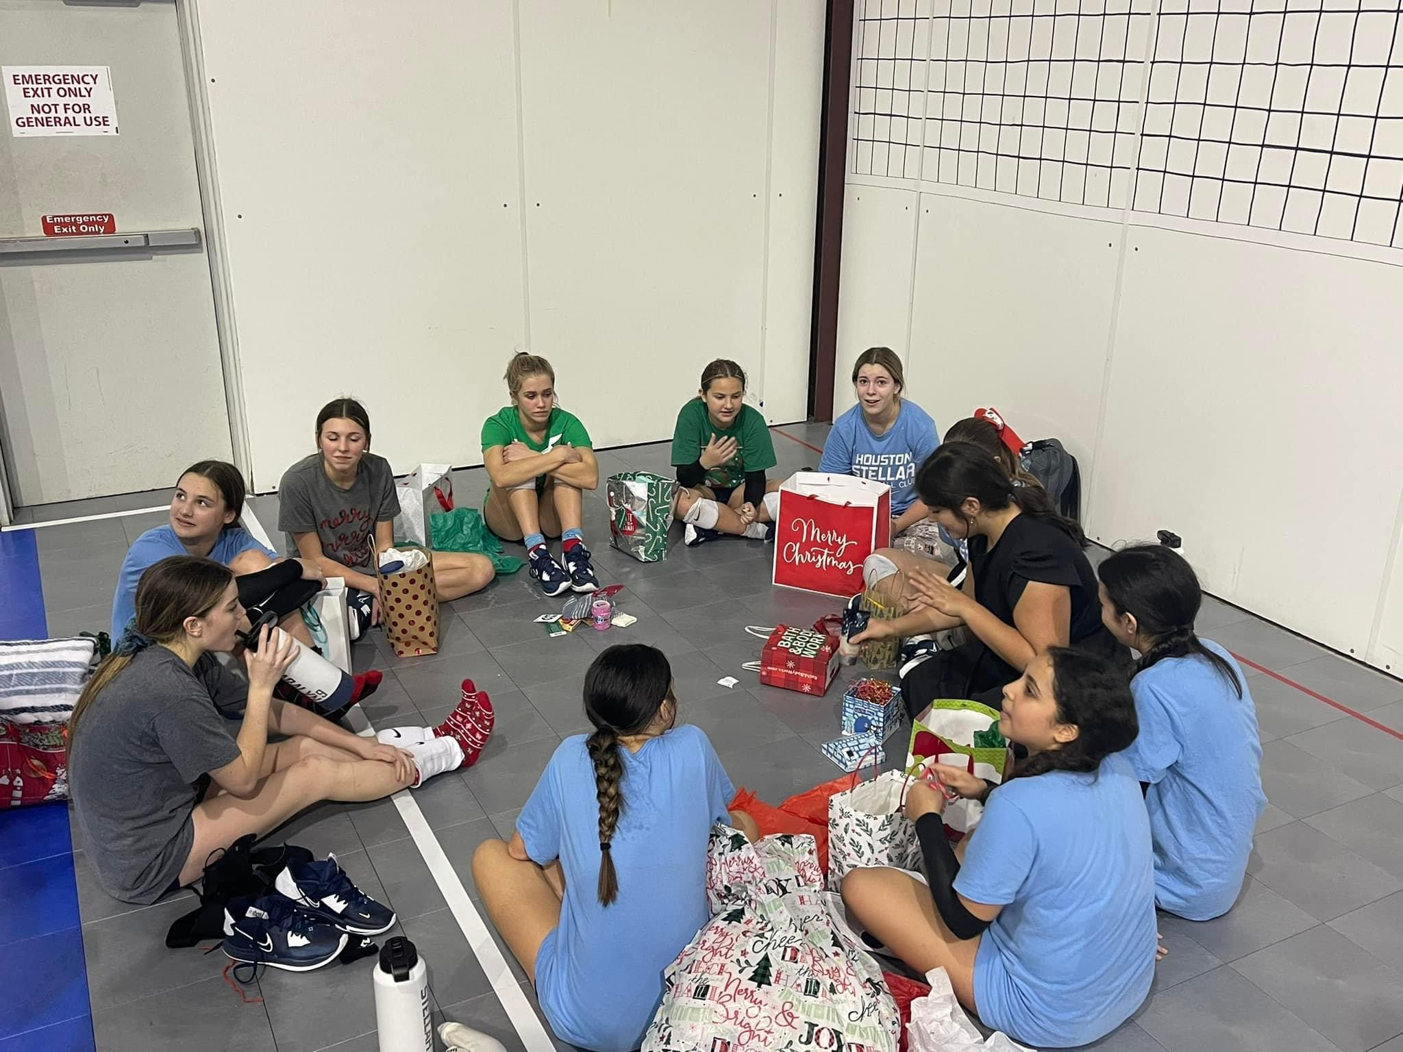
IMPORTANT INFORMATION
Thanksgiving Break: November 19-26
Stellar Social/Gear Pickup: November 25th
  We will take head shots during this time, so everyone needs to be picture ready.
Practices Start the week of November 27th.
  If players are still in playoffs, they will not practice with their club teams
  until after they finish their high school season.
  DST will start the following week for Elite teams and those that sign up for
  the extra classes offered.
  December 22nd -1st is Christmas Break.
  Spring Break is arch 11th-17th
  Easter is March 31st

Slide 16

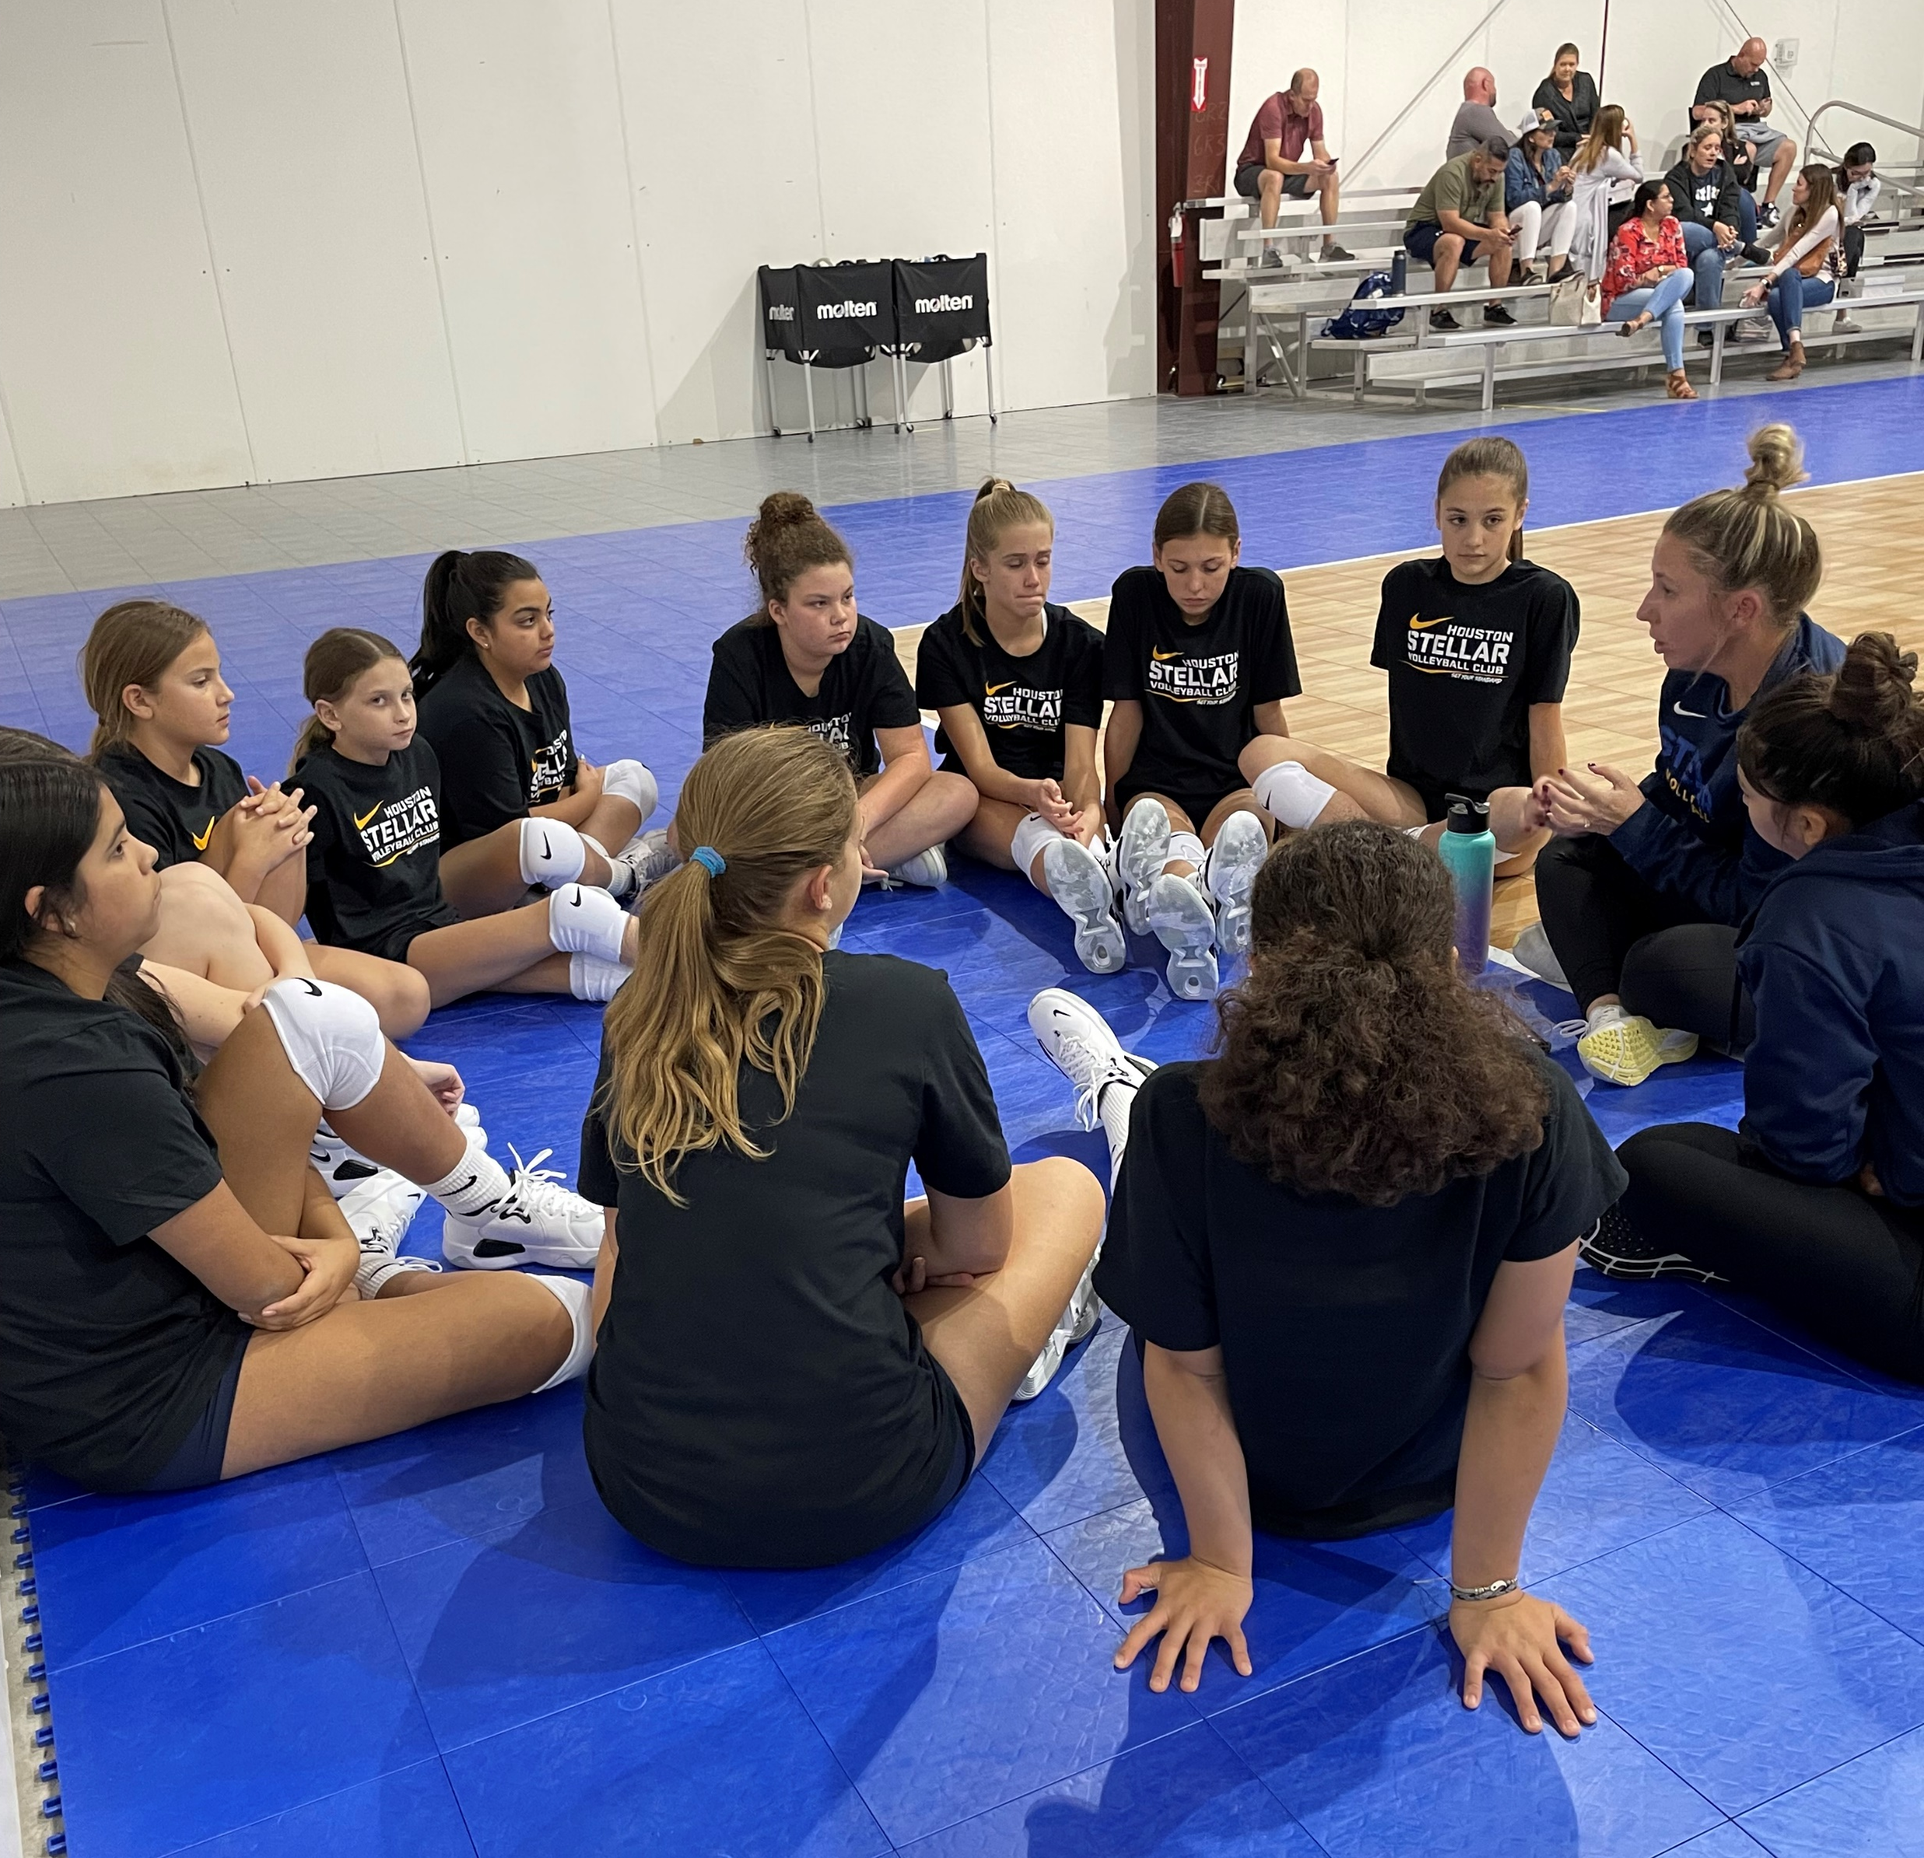
WEEK 1 – INTRO PRACTICES

Slide 17
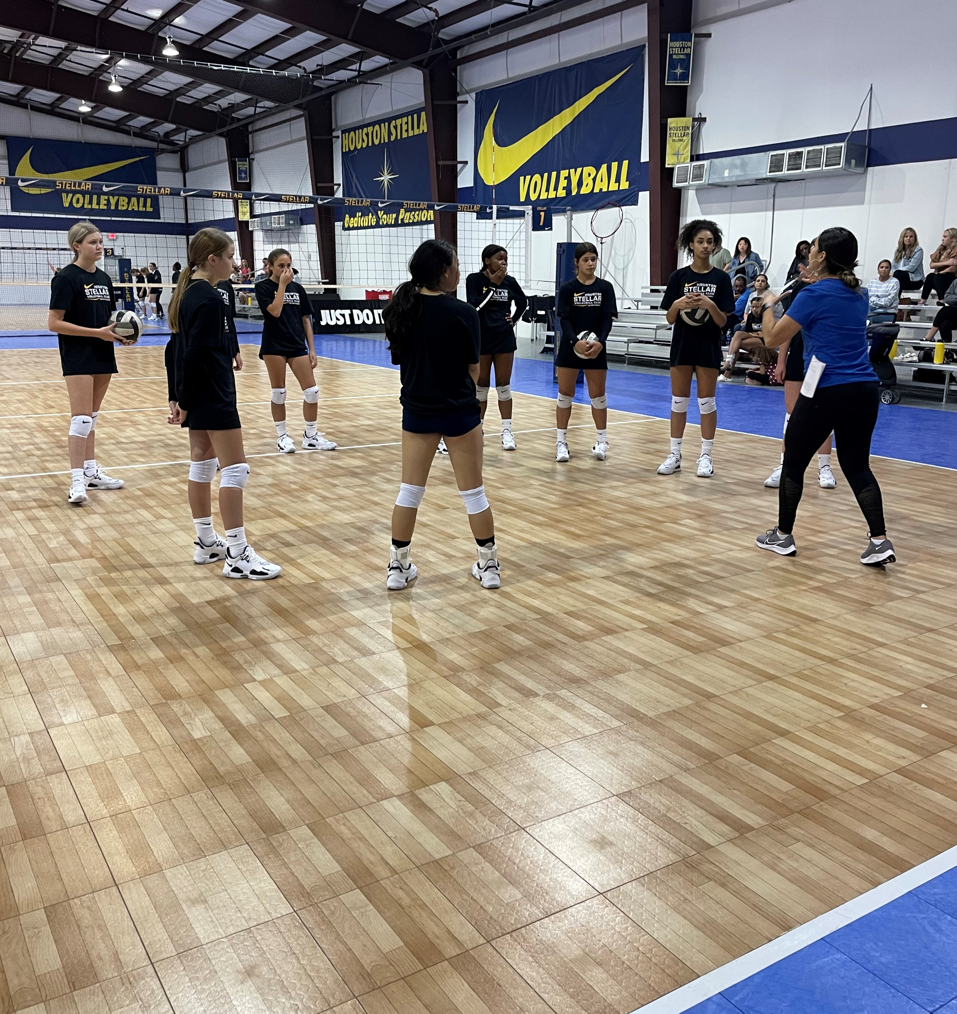
INTRO PRACTICE WEEK
Start with a Small Introduction of your team.
Coaches take the time to tell your team about you and your playing/coaching backgrounds.
2024 Motto
Gear
Picking Up/Organized
Team Agreements
On Court: Warm Up
On Court: Stretching
On Court: Ball Warm Up
Offensive Play Review
Defense
13s Up: 6-On Movement / 12s below: Fundamental Footwork

